Slide 1

SOFTWARE QUALITY ENGINEERING
BS Software Engineering
Semester, Fall 2025
Credit Hours 2-1
Instructor: Naseer Jan
Department of Creative Technologies
Air University
Islamabad, Pakistan

Slide 2
Agenda
Week 1 Review
If statement, Switch and loops
Subtopics
  Break statement

Slide 3
Software Quality
The question, “What is software quality?’, is bound to generate many different answers,
depending on whom you ask, under what circumstances, for what kind of software systems,
and so on.
What are the characteristics for high-quality software?
define software quality by defining the expected characteristics or properties of high-quality software. In doing so, we need to examine the different perspectives and expectations of users as well as other people involved with the development, management, marketing, and maintenance of the software products.
We also need to examine the individual characteristics associated with quality and their inter-relationship, and focus our attention on the critical characteristics of functional correctness.

Slide 4

Quality Perspectives and Expectation
different views of quality in a systematic manner, based on the different roles, responsibilities, and quality expectations of different people, and zoom in on a small set of views and related properties.
Five major views according to are:
  Transcendental: It is generally associated with some intangible properties that delight users.
  User: quality is fitness for purpose or meeting user’s needs.
  Manufacturing: quality means conformance to process standards
  Product: the focus is on inherent characteristics in the product itself in the hope that controlling these internal quality indicators (or the so-called product internal metrics) will result in improved external product behavior (quality in use)
  value-based views: quality is the customers’ willingness to pay for a software.

Slide 5
People Roles and Responsibilities
When software quality is concerned, different people would have different views and expectations based on their roles and responsibilities.
With the quality assurance and quality engineering, we can divide the people into two broad groups:
Consumers of software products or services, including customers and users, either internally or externally.
  customers (acquisition of software products or services)
  the users (who use the software products or services for various purposes)
  non-human or “invisible” users as other software, embedded hardware, and the overall operational environment that the software operates under and interacts with .

Slide 6
People Roles and Responsibilities
Producers of software products, or anyone involved with the development, management, maintenance, marketing, and service of software products.
We adopt a broad definition of producers, which also include third-party participants who may be involved in add-on products and services, software packaging, software certification, fulfilling independent verification and validation (IV&V) responsibilities, and so on.

Slide 7
Quality Expectation on Consumer Side
The basic quality expectations of a user are that a software system performs useful functions as it is specified.
There are two basic elements to this expectation:
  First, it performs right functions as specified, which, hopefully fits the user’s needs (fit for use).
  Second, it performs these specified functions correctly over repeated use or over a long period of time, or performs its functions reliably.
  These two elements are related to the validation and verification aspects of QA.
meeting this basic expectation and beyond to delight customers and users by preventing unforeseen negative impacts and produce unexpected positive effects

Slide 8
Quality Expectation on Consumer Side
For many users, ease of use, or usability, may be a more important quality expectation than reliability or other concerns.
For example, the adoption of graphical user interfaces (GUI) in personal computers to replace text based command interpreters often used in mainframes is primarily driven by the usability concerns for their massive user population.
Similarly, some users prefer ease of installation. However, different users of the same system may have different views and priorities, such as the importance of usability for novice users and the importance of reliability for sophisticated users of the web.

Slide 9
Quality Expectation on Producers Side
For software producers, the most fundamental quality question is to fulfill their contractual obligations by producing software products that conform to product specifications or providing services that conform to service agreement.
By extension, various product internal characteristics that make it easy to conform to product specifications, such as good designs that maintain conceptual integrity of product components and reduce coupling across different components, are also associated with good quality.
For product and service managers, following factors are closely related to quality as follows:
  adherence to pre-selected software process
  and relevant standards
  proper choice of software methodologies
  languages
  tools
  selecting appropriate and effective QA strategies

Slide 10
Quality Framework and ISO 9126
Various so-called “-ilities” connected to the term quality, such as reliability, usability, portability, maintainability, etc.
Various models or frameworks have been proposed to accommodate these different quality views and expectations, and to define quality and related attributes, features, characteristics, and measurements.
ISO-9126(ISO, 2001), the mostly influential one in the software engineering community today, and discuss various adaptations of such quality frameworks for specific application environments.

Slide 11
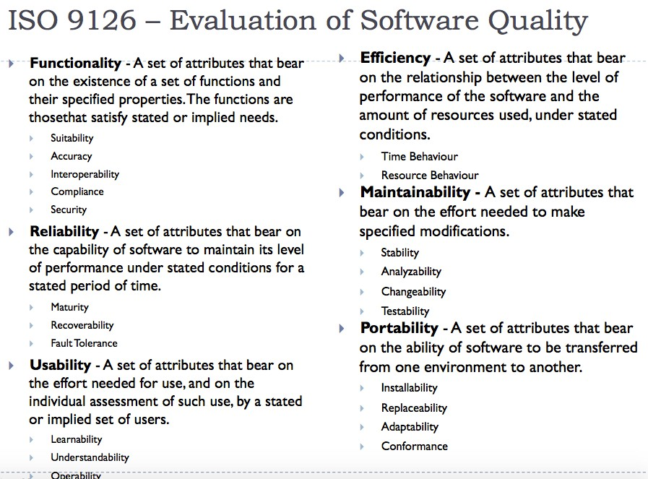

Slide 12
Defect, Failure, Fault and Error
Key to the correctness aspect of software quality is the concept of defect, failure, fault, and error.
defect: refers to some problem with the software, either with
its external behavior or with its internal characteristics.
Failure: The inability of a system or component to perform its required functions
within specified performance requirements.
Fault: An incorrect step, process, or data definition in a computer program.
Error: A human action that produces an incorrect result.
Therefore, the term failure refers to a behavioral deviation from the user requirement
or the product specification
fault refers to an underlying condition within a software that
causes certain failure(s) to occur
while error refers to a missing or incorrect human action
resulting in certain fault(s) being injected in to a software.

Slide 13
Defect, Failure, Fault and Error
We also extend errors to include error sources, or the root causes for the missing or
incorrect actions, such as human misconceptions, misunderstandings, etc.
Failures, faults, and errors are collectively referred to as defects in literature.
Software problems or defects, are also commonly referred to as “bugs”. However, the term bug is never precisely defined, such as the different aspects of defects defined as errors, faults, and failures above.

Slide 14
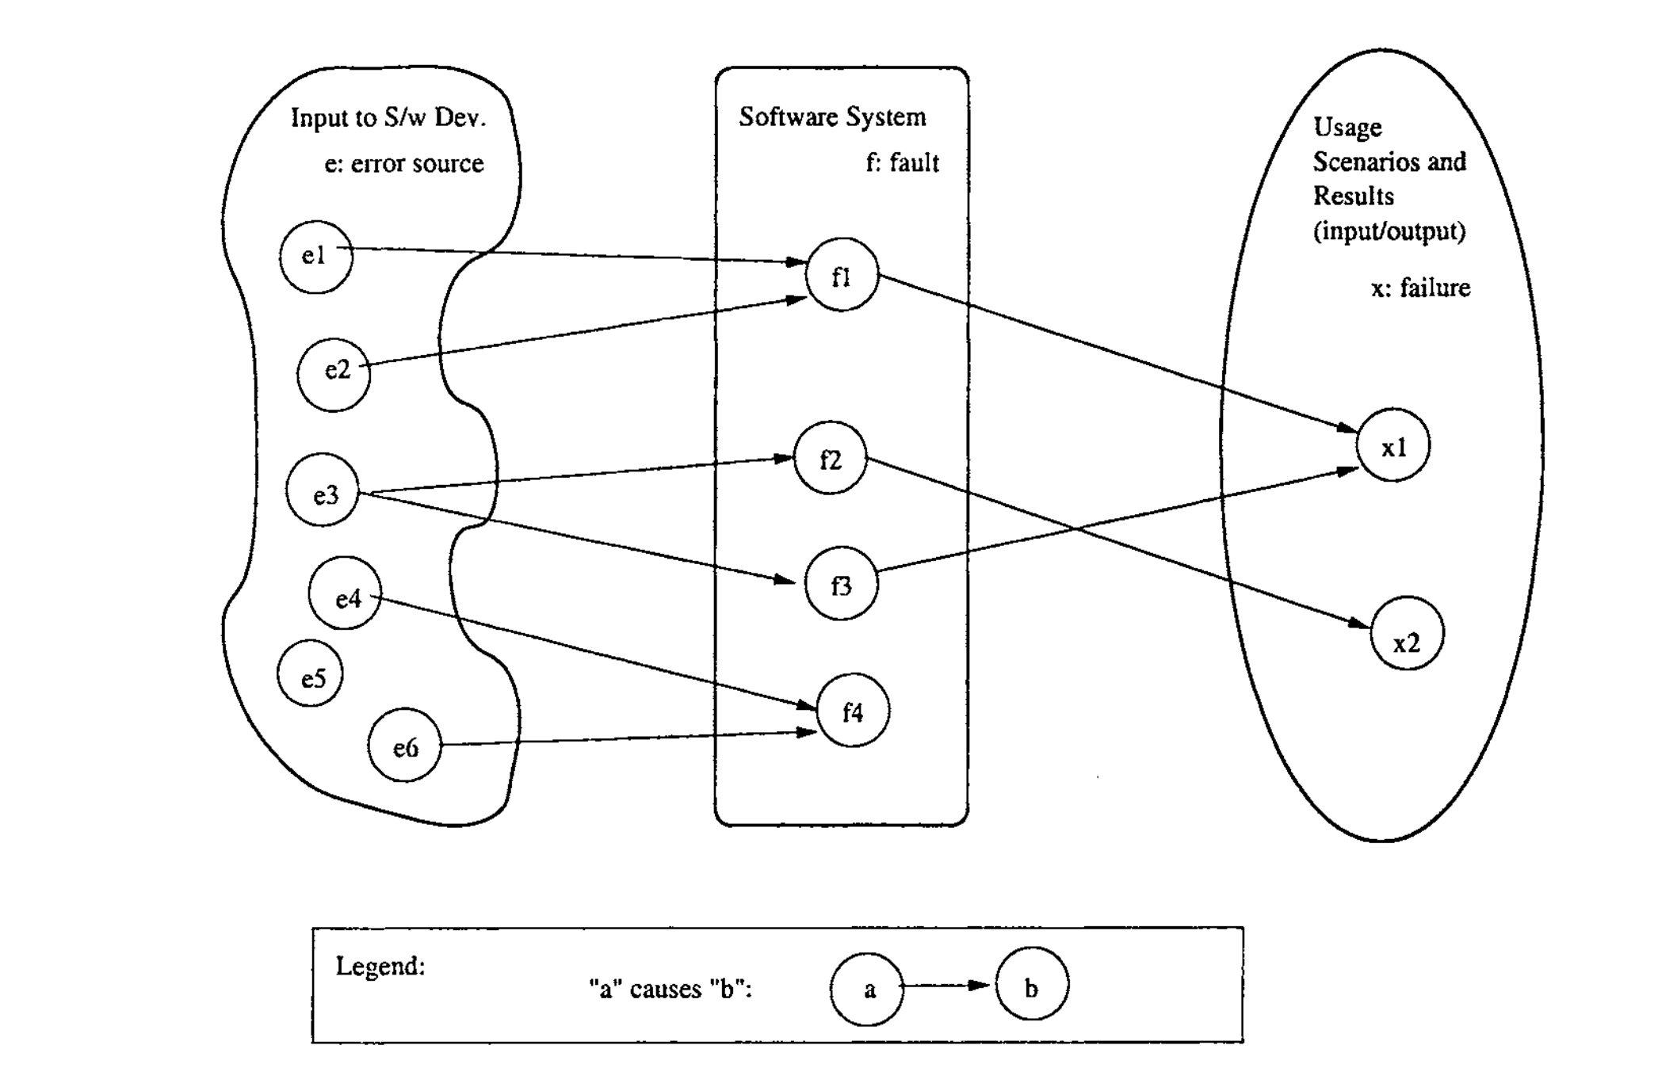
Defect, Failure, Fault and Error

Slide 15
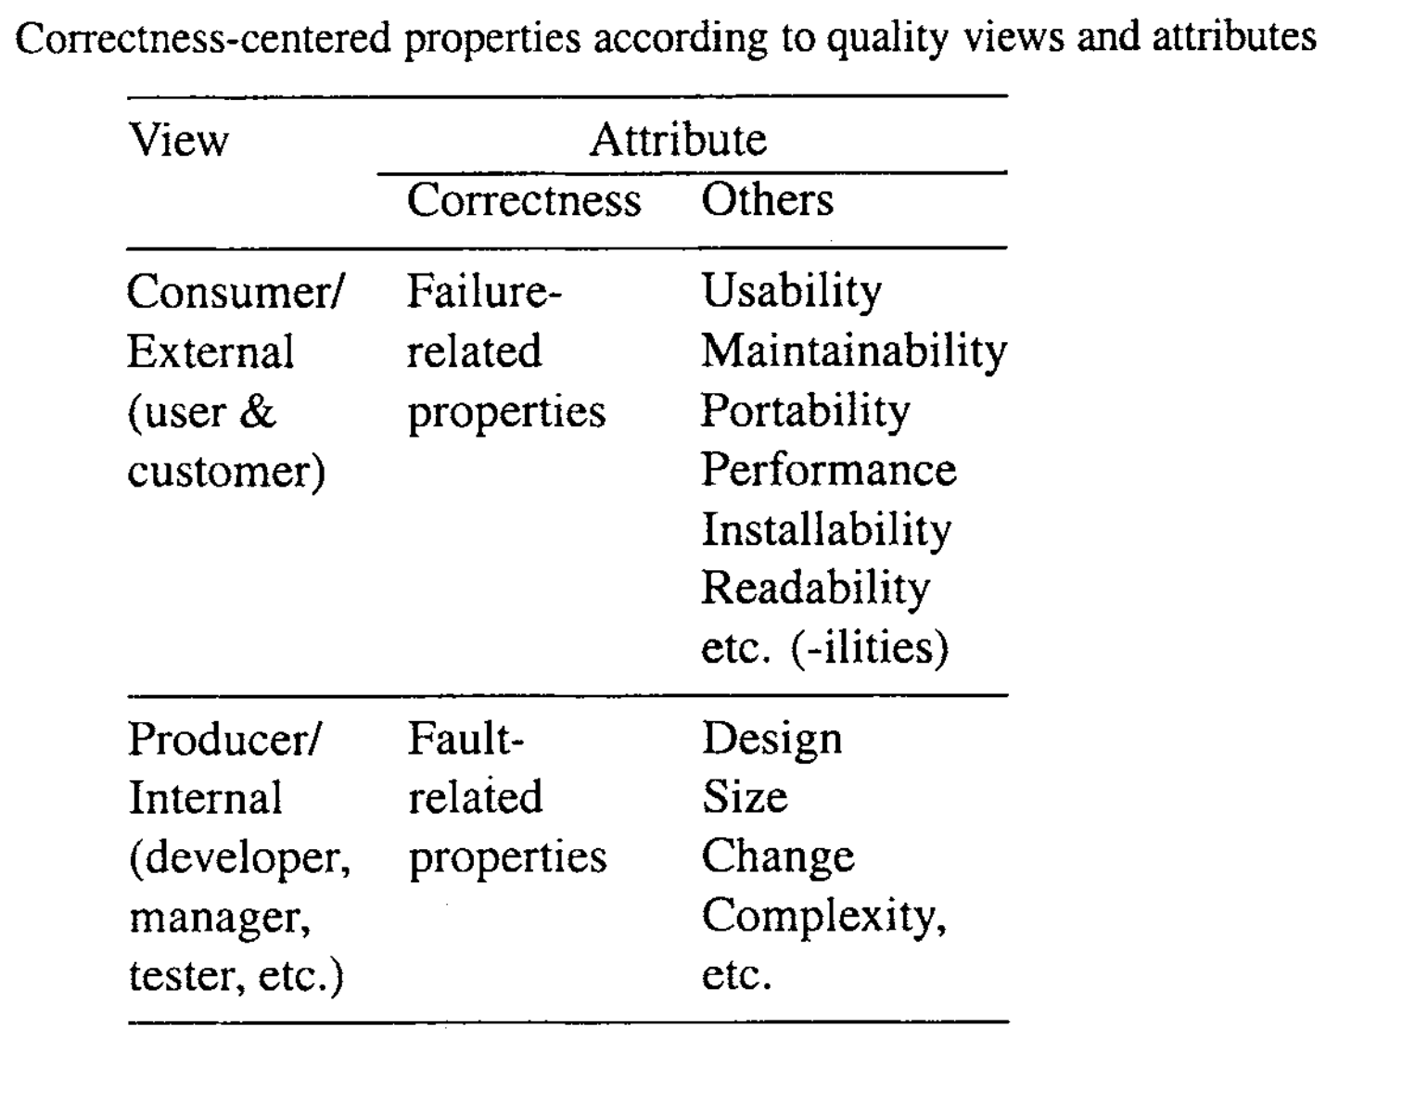
Defect, Failure, Fault and Error

Slide 16
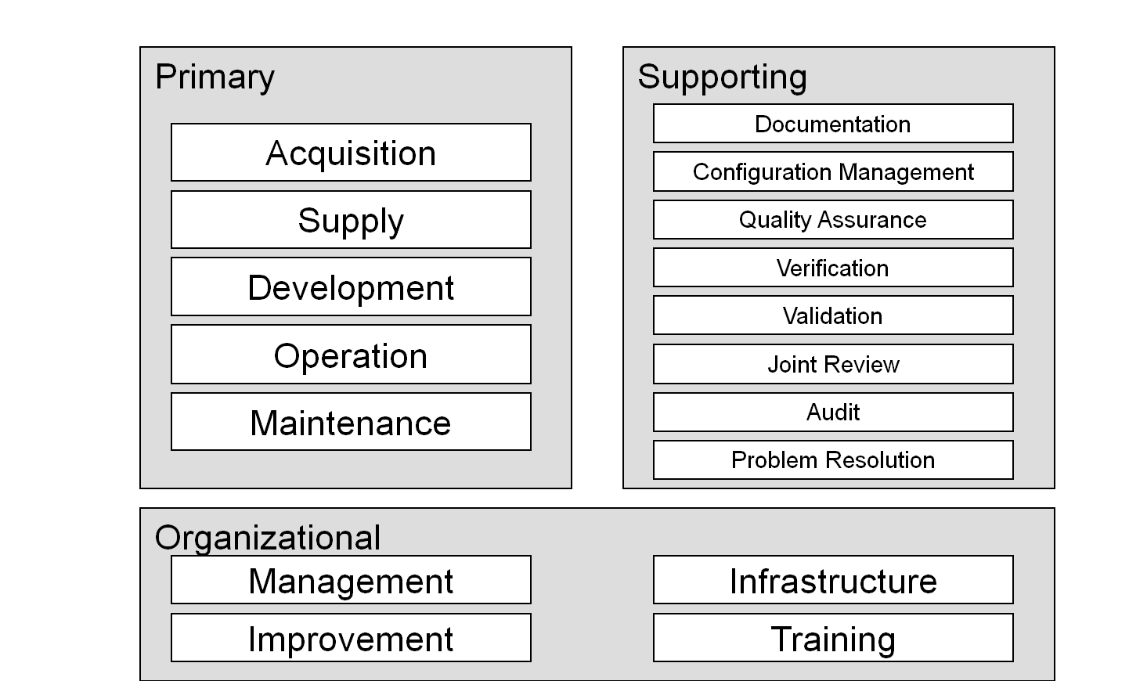
ISO/IEC12207 Software Life Cycle Processes (Software Processes)

Slide 17
Software Development Process
Software requirements analysis
Software architectural design
Software detailed design
Software coding and testing
Software integration
Software qualification testing
System integration
System qualification testing
Software installation
Software acceptance support

Slide 18
Quality in Software Development

Slide 19
Software Development Process
Software development should be carried out by following the principles, standards and procedures designed to develop a software product (Tauqeer)
Standardize software development assures; Good hand on Analyzing, Flexible and changeable design, Traceability, Refactoring in coding, Testability, Maintainability (Syed)
Conformance to the coding conventions (organization specific) (Nauman)
Structured, commented, well-organized implementation (Michael)
We have to carry out the whole life cycle to attain quality in software development i.e. quality in every phase (Karuna)

Slide 20
Quality in Software Process

Slide 21
Quality in Software Processes
Visibility and transparency of process (E.g. in tracking progress) (Nauman)
A process that is predictable and provide what we expect to have (Eyaye)
Following standards make each process clear and easy to handle in future (Aftab)
The prevailing maturity level (Isong)
Use standardized approach as international standards-ISO/IEC TR 15504 series as a framework to assess the software processes (Jia)
Team members can realize gaps between the process and reality (practice) and they can identify how to improve the process (Abdullah)

Slide 22
Quality in Software Products

Slide 23
Quality in Software Products
Degree to which this software meets pre-defined requirements and expectations (Saleh).
All the following quality attributes should be included in software product (Asar Jan).
Means quality in end product: Satisfy the customer needs and expectations, Reliability, Availability, Performance, Usability, Easy to maintain, Provide flexibility (Usman)
Conformance to the stated qualities of the product. It is like a degree of the contractual agreement that is fulfilled (Phani).
Meaning of a quality software product is different for end users, buyers, developers, maintainers (Sajad).
Quality of final product depends mostly on the quality of software process (Kranthi)

Slide 24
Questions
Questions and Answers sessions

Slide 25


